Slide 1
N
(-1,2)
(1,1)
W
E
S

Slide 2


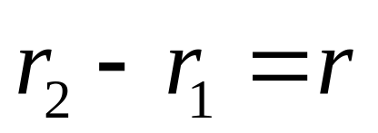


N
Difference of
(-1,2)
(1,1)
W
E
position vectors
is vector too
Displacement
S

Slide 3
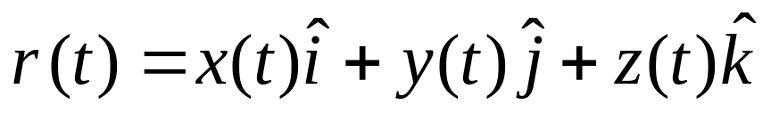
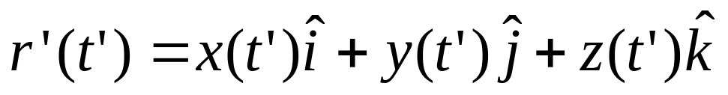
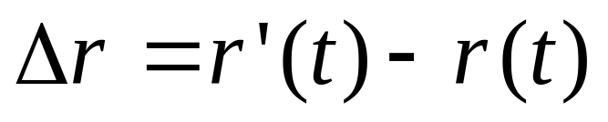

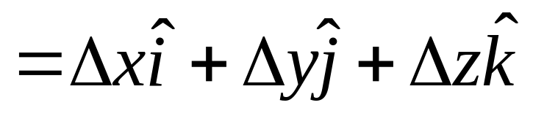
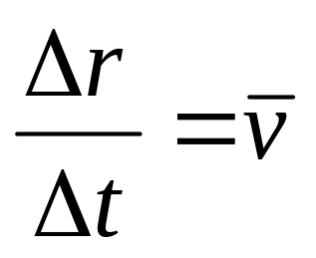
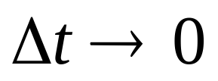
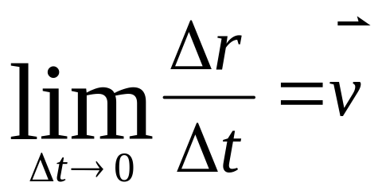
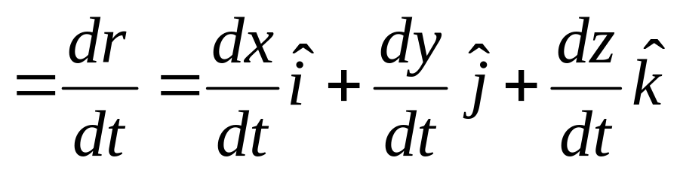
Position, velocity and Acceleration
Displacement
r is function of time t: r=r(t).
z
position
Δr
r
y
Average Velocity
x
Instantaneous Velocity

Slide 4
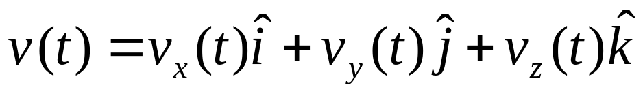
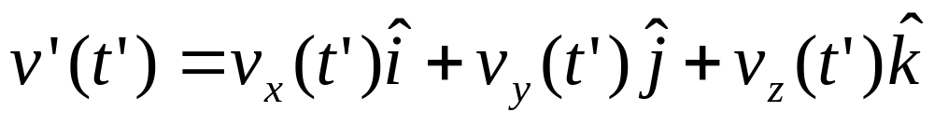
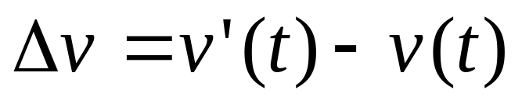
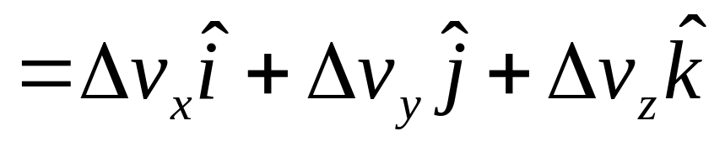
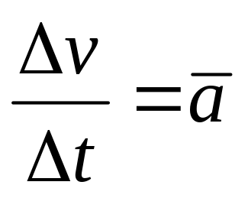

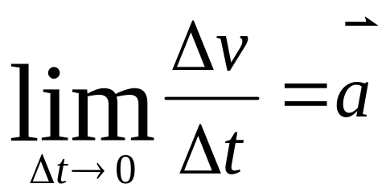
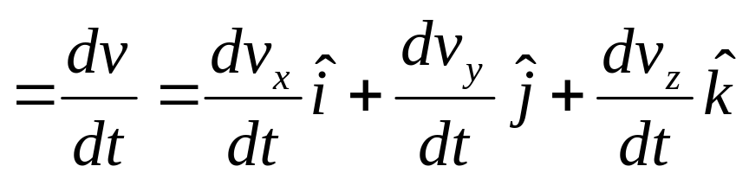
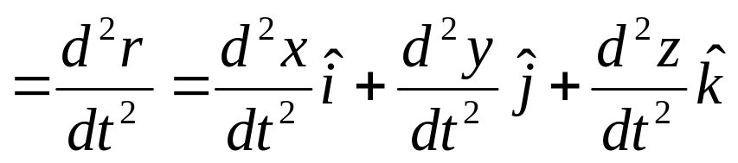
Position, velocity and Acceleration
Displacement
z
position
Δr
r
y
Average acceleration
x
Instantaneous acceleration

Slide 5
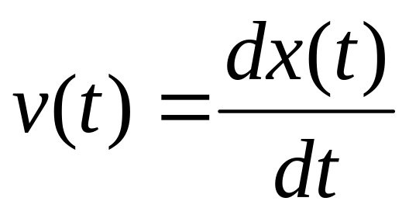
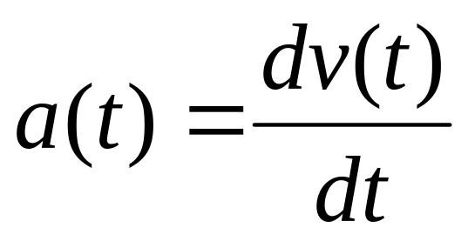
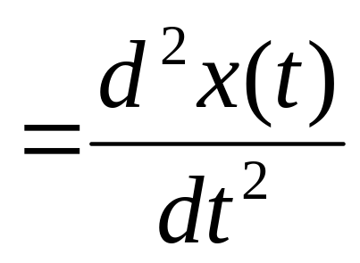
Motion in one dimension
x(t)
0
x=x(t)

Slide 6
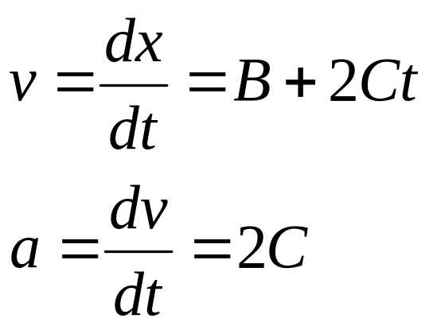
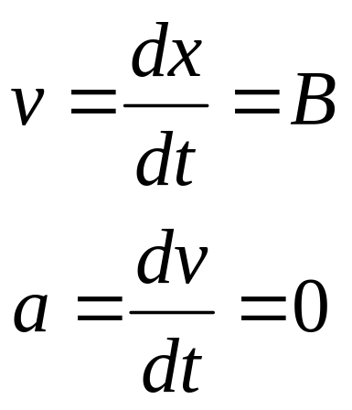
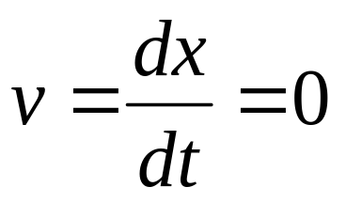
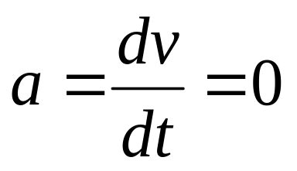
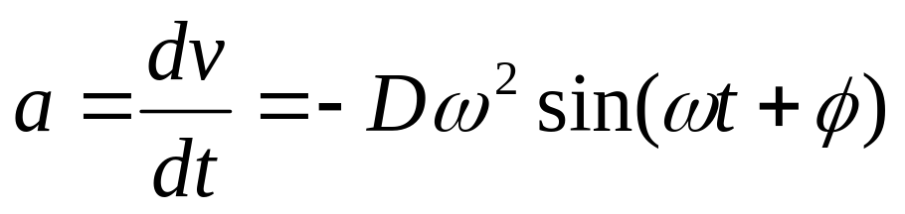
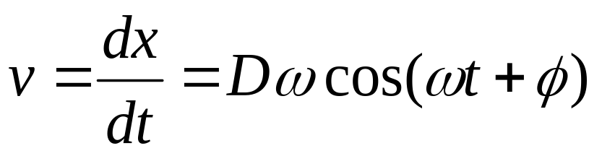
X=A+Bt+Ct²
X(t)
X=A+Bt
X=A
A
X=Dsin(ωt+φ)
t
0

Slide 7
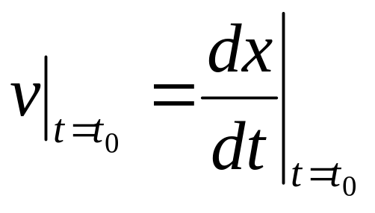
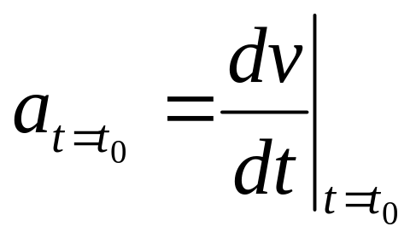
x(t)
Slope at t₀
t₀
t
v(t)
Slope at t₀
t₀
t

Slide 8
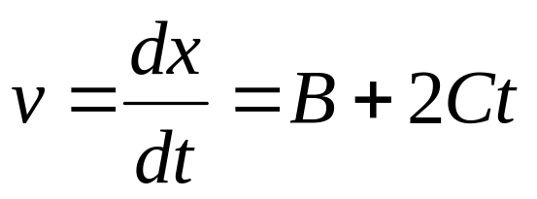
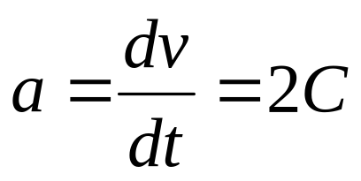
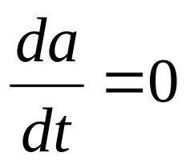
Motion with constant acceleration
x=A+Bt+Ct²
x(t)
v(t)
Slope
Slope
t
t
a(t)
Slope=0
t

Slide 9
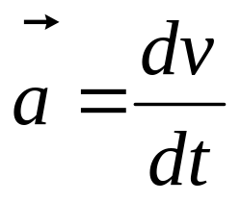
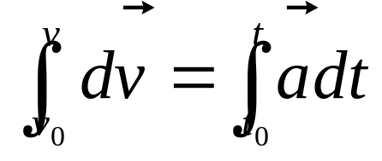

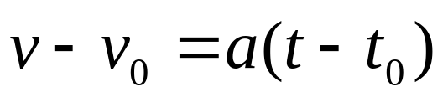
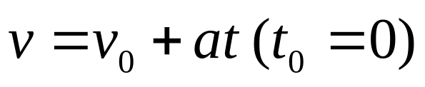
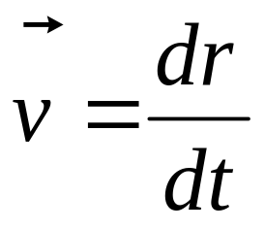
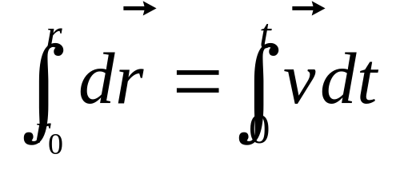
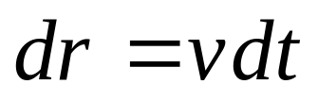
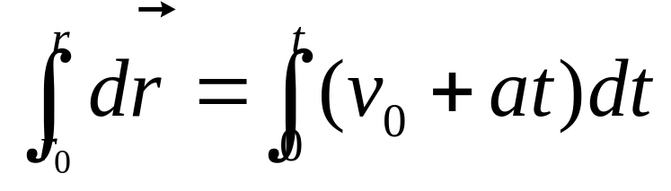
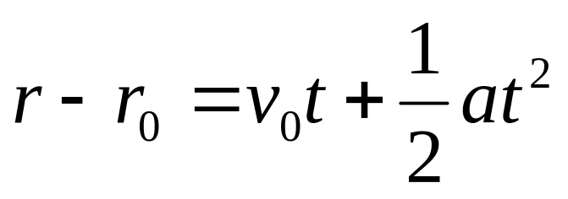
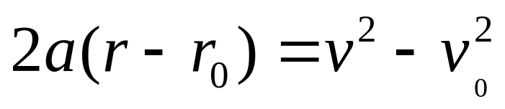
Motion with constant acceleration

Slide 10

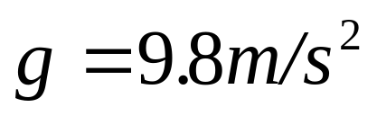


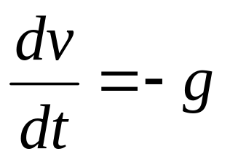
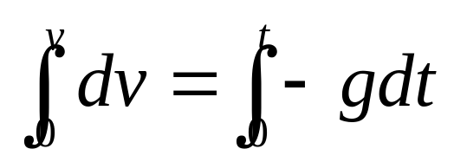
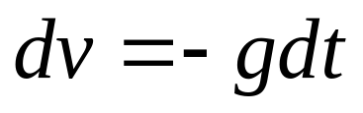
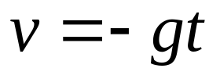

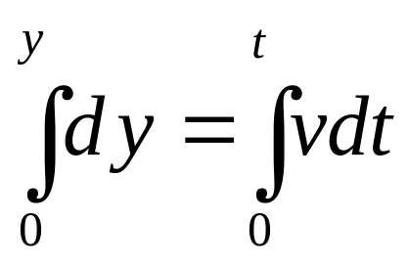
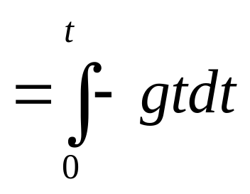
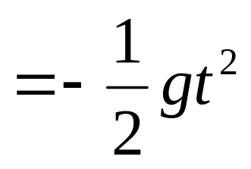
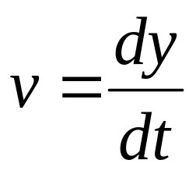


Freely Falling Bodies

Slide 11
Chap. 3
Force and Newton’s law

Slide 12
Force and Motion

Slide 13
The force laws
Environment
Force
Body
Motion
The motion laws
Consider a body on which no net force acts. If the body is at rest, it will remain at rest. If the body is moving with constant velocity, it will continue to do so.
The reference frames to which is applies are called inertial frames.
Newton’s Frist Laws

Slide 14


s frames
inertial frames
S’ frames
Not an inertial frames
S’’ frames

Slide 15






Same force acting on
Mass
Newton’s Second Laws

Slide 16


Newton’s Third Laws

Slide 17


environment.
a
F’
F
The force is an interaction between
a body and its environment.
if F=0, motion not change
1st Newton’s law
The force acting on a body will accelerate it
2nd Newton’s law
3rd Newton’s law

Slide 18
W=mg
g
W
environment.

Slide 19








The force is a vector
No net force

Slide 20
L

Slide 21
L+ΔL
Spring Force

Slide 22


a
L+ΔL
Spring Force
Frictional Force
Spring Force
Gravity

Slide 23
External force and internal force
F_{ext}
F_{ext}
F_{int} F_{int}

Slide 24
UNIT OF FORCE
newton, N
1N = 1 Kg•m/s²
[ F ] = ML/T²

Slide 25












In one dimension
F = ma, if F = constant, a =constant
If F ≠ constant, a ≠ constant

Slide 26







example

Slide 27














force depending on the velocity.
v(t)
D
D = bv
Σ F = mg-bv
= ma
a(t)
D
mg-bv = m dv/dt
mg/b
t
t
mg
mg
mg

